Slide 1
Clustering Coefficient
MA 653: Network Science
Instructor: Ashok Singh Sairam
ashok@iitg.ac.in

Slide 2
Recap
We discussed some simple concepts of network groups to probe and describe the local structure of networks
Clique
k-plex
k-core
k-components: At least k vertex independent path between every pair of nodes
A 1-component is an ordinary component
A 2-component (bi-component) is a subset of a 1-component
A tri-component is a subset of a bi-component and so forth
The k-components need not be contiguous

Slide 3
Example: k-components
the k-components in a network can be non-contiguous => The two highlighted vertices (0,4) in this network form a tricomponent, even though they are not directly connected to each other. The other three vertices are not in the tricomponent.
Note that for k ≥ 3, the k-components in a network can be non-contiguous (see figure). Ordinary components (1-components) and bicomponents, by contrast, are always contiguous.
2
4
1
0
3
Notes:
.

Slide 4
Transitivity
Transitivity is important in social networks
Not that much in other types of networks
A relation ° is transitive if
The most simple – but also important – relation in a social network is “connected by an edge”
If vertex u is connected by an edge with v, and v is connected by an edge with w, then u is connected by an edge with w
Perfect transitivity only occurs in networks where each component is a fully connected subgraph or clique

Slide 5
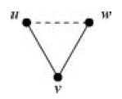
Quantifying Transitivity
u knows v and v knows w
we have a path uvw, two edges long (solid line)
If u also know w, we say that the path is closed
the path uvw (solid edges) is closed if the third edge uw is present (dashed line)
a loop of length 3, or a triangle is formed
In social network jargon, u, v, and w are said to form a closed triad
Partial transitivity can be also useful
The fact that u knows v and v knows w, does not mean that u must know w
However, it increases the probability that u knows w

Slide 6
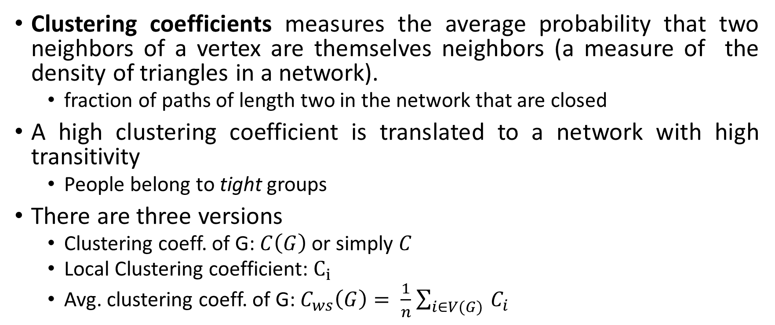
Clustering Coefficient
Clustering coefficients measures the average probability that two neighbors of a vertex are themselves neighbors (a measure of the density of triangles in a network).
fraction of paths of length two in the network that are closed
A high clustering coefficient is translated to a network with high transitivity
People belong to tight groups
There are three versions
Clustering coeff. of G: $C\left(G\right)$ or simply $C$
Local Clustering coefficient: $C_{i}$
Avg. clustering coeff. of G: $C_{ws}\left(G\right)= \frac{1}{n}$ $\sum_{i∈V(G) }{C_{i}}$

Slide 7
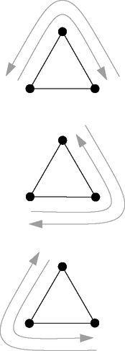
Clustering coefficient
Another way to compute the above expression is by counting the number of triangles that appear in the network
Every triangle contains 6 paths of length two and hence:
Alternatively, a connected triple can be defined as a set of three nodes uvw with edges (u,v) and (v,w):
Edge (u,w) can be present or not

Slide 8
Ex: Clustering Coefficient
Find the clustering coefficient
1
4
3
2
5
C = 3/[1(4,3,5) + 2(4,3,1 & 4,3,2) + 2(5,3,1 & 5,3,2) + 3(1,2,3 & 2,3,1 & 3,1,2)]
=> C = 3/8

Slide 9
Clustering coefficient in directed networks
In a directed network, traditionally CC is computed by assuming no direction on the edges
There are extensions that consider edge direction
E.g., if “u points/likes v” and “v points/likes w”, then “u points/likes w”
These extensions have not found a widespread application in the literature

Slide 10
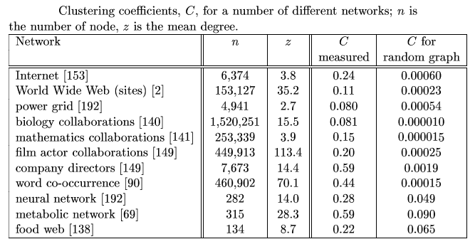
Clustering coefficient in social networks

Slide 11
Local clustering
As we said clustering coefficient can be defined for a single vertex as well:
That is, to calculate Ci we go through all distinct pairs of vertices that are neighbors of i in the network, count the number of such pairs that are connected to each other, and divide by the total number of pairs, which is (½)ki*(ki-1) where ki is the degree of i,. Ci is sometimes called the local clustering coefficient and it represents the average probability that a pair of i′s friends are friends of one another.
If we find the average clustering coefficient from all vertices of a network, we practically have the clustering coefficient of the network
Clustering coefficient is closely related with “structural holes”

Slide 12
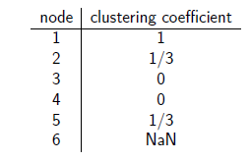
Ex: Local Clustering Coefficient
Find the clustering coefficient and local clustering coefficient of each node
1
2
5
3
4
6

Slide 13
Structural holes
While it is common for the neighbors of a vertex to be connected among themselves, it happens sometimes that these expected connections between neighbors are missing
These missing links are called structural holes
Structural holes can be a bad thing with regards
to efficient spread of information
Information has fewer routes to move around
They are good though for the vertex u
Hence, local clustering coefficient could be a measure of possible influence of the specific vertex (lower value is better), as it implies presence of many structural holes, i.e., structural holes can be a good thing for the central vertex u whose friends lack connections, because they give u power over information flow between those friends.
v
u
w
y
x

Slide 14
Significance of clustering coefficient
Clustering coefficient is a measure of the degree to which nodes in a graph tend to cluster together.
Evidence suggests that in most real-world networks, and in particular social networks, nodes tend to create tightly knit groups characterized by a relatively high density of ties;
this likelihood tends to be greater than the average probability of a tie randomly established between two nodes.
Empirically vertices with higher degree have a lower local clustering coefficient on average.
Local clustering can be used as a probe for the existence of so-called structural holes in a network, which are missing links between neighbors of a person

Slide 15

Redundancy
The redundancy R_{i} of a vertex i is the mean number of connections from a neighbor of i to other neighbors of i
$Ri=\frac{1}{4}(0+1+1+2)$=1
Redundancy for a node i takes values from 0 to k_{i}-1 => Max = [2*(1/2)* k_{i} *(k_{i} -1)] / k_{i} (k_{i} is the degree of i)
a
c
i
b
d

Slide 16
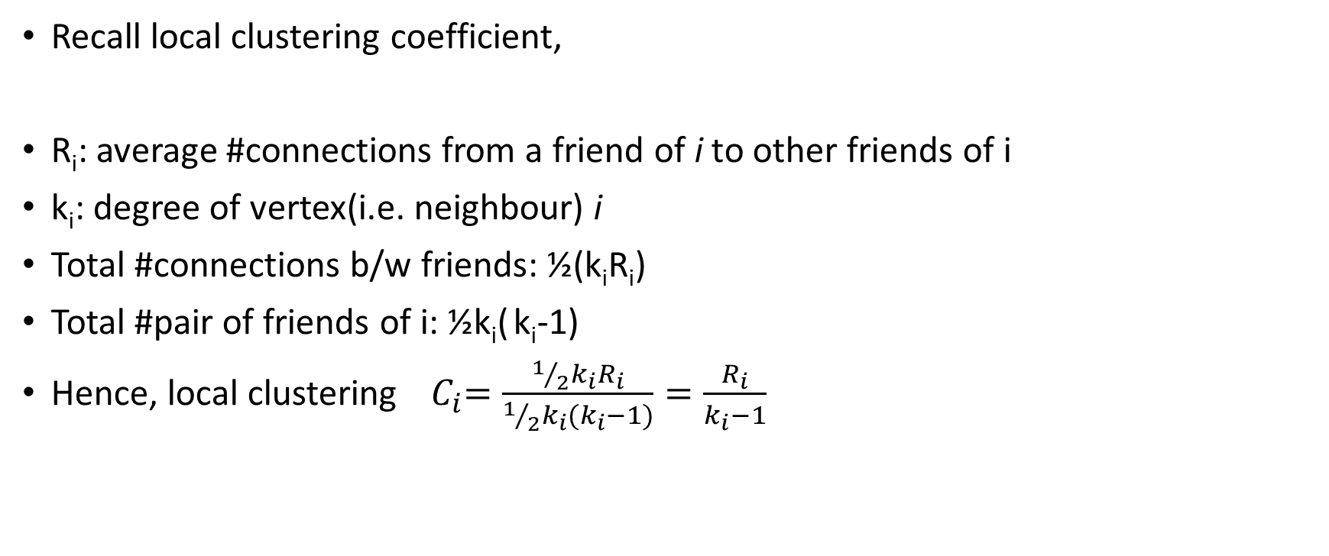
Relation b/w local redundancy and local CC
Recall local clustering coefficient,
R_{i}: average #connections from a friend of i to other friends of i
k_{i}: degree of vertex(i.e. neighbour) i
Total #connections b/w friends: ½(k_{i}R_{i})
Total #pair of friends of i: ½k_{i}( k_{i}-1)
Hence, local clustering${ C}_{i}=\frac{1/2k_{i}R_{i}}{1/2k_{i}(k_{i}−1)}=\frac{R_{i}}{k_{i}−1}$
a
c
i
b
d

Slide 17
Local vs Global clustering coefficient
Watts and Strogatz have suggested computing the clustering coefficient of a network as the average over all the local clustering coefficients of the vertices:
n is the #vertices
NOTE: This definition gives different result than the previous one on global cc
The above definition tends to give high cc values for networks dominated by vertices of low degree (why? => bcoz for low degree, local cc value will be higher, hence, avg cc value will be higher) – which is regularly the case in real networks

Slide 18
C vs. C_{ws}
1/1=1
A
D
B
2/(3*2/2)=2/3
3/(4*3/2)=1/2
E
C
1/(2*1/2)=1
2/(3*2/2)=2/3
CC_{WS}=(1+1/2+1+2/3+2/3)/5=0.7666…
C= ? = 3*3/(1+6+1+3+3) = 9/14 = 0.6428571….(???)

Slide 19
What value of clustering coefficient is high?
The notion of high clustering coefficient is relevant
We define the edge density p of a network as:
If we pick a pair of vertices at random, the probability that they are connected is p
If we pick a pair of vertices with a common connection at random, then the probability that they are connected is C
Hence if C >> p, we say that the network has a high clustering coefficient
So is the clustering coefficient high in the previous network?
Ans: p=7/10 & C = 9/14 => No, clustering coefficient is not high in the previous network
Notes:
*

Slide 20
Reciprocity
The CC is examining loops of length 3 – this is the smallest possible loop size in an undirected network
However, in directed networks there
can be loops of size 2
directed edge running in both directions
Reciprocity measures the frequency of length 2 loops in a directed network
If there is a directed edge from i to j and there is also an edge from j to i then we say that the edge (i,j) – or the edge (j,i) – is reciprocated
Such pair of links aka co-links

Slide 21
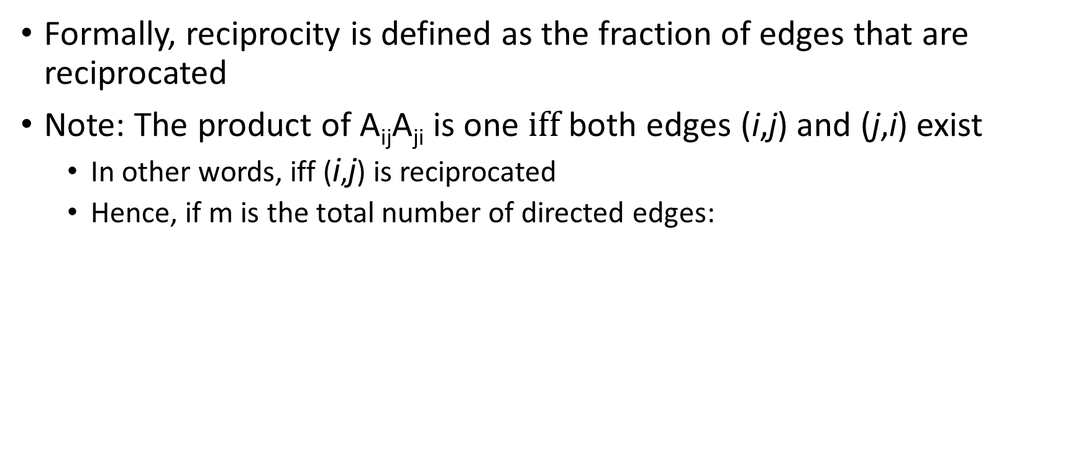

Reciprocity
Formally, reciprocity is defined as the fraction of edges that are reciprocated
Note: The product of A_{ij}A_{ji} is one $iff$ both edges (i,j) and (j,i) exist
In other words, iff (i,j) is reciprocated
Hence, if m is the total number of directed edges:
i
What is the reciprocity in this network?
Ans: 4/7
k
j
l

Slide 22
Exercise
7.11 Among all pairs of vertices in a directed network that are connected by an edge or edges, suppose that half are connected in only one direction and the rest are connected in both directions.
What is the reciprocity of the network?
Ans: ¼(???) or 2/3(???)

